Slide 1
Spring 2025-CSE332 Computer Organization and Architecture

Slide 2
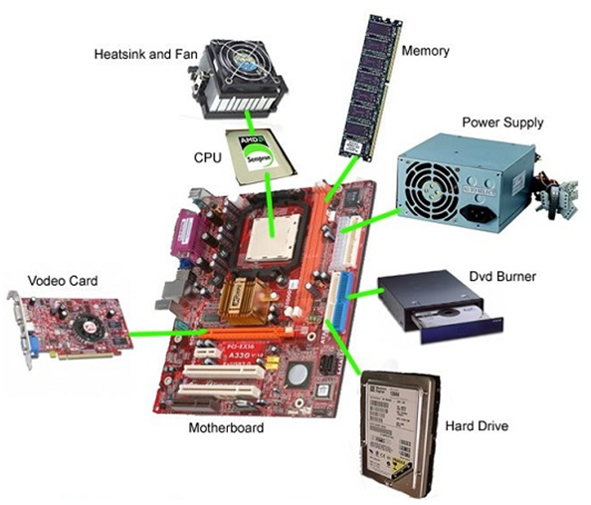

Slide 3
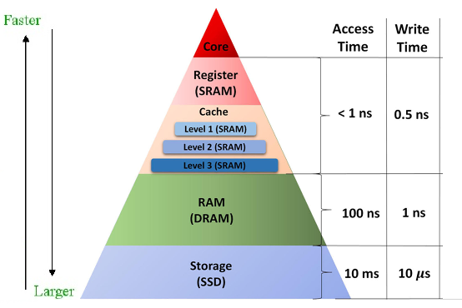
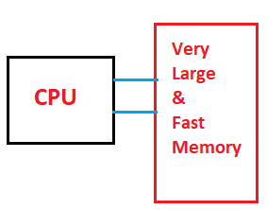
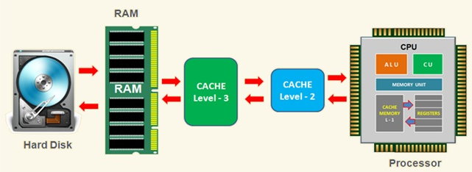
Hierarchy of Memories: why
Programmers want memory to be fast and large but cheap as well.
Fast and large memory is very expensive.
Solution: hierarchy of memories to optimize cost and speed.

Slide 4
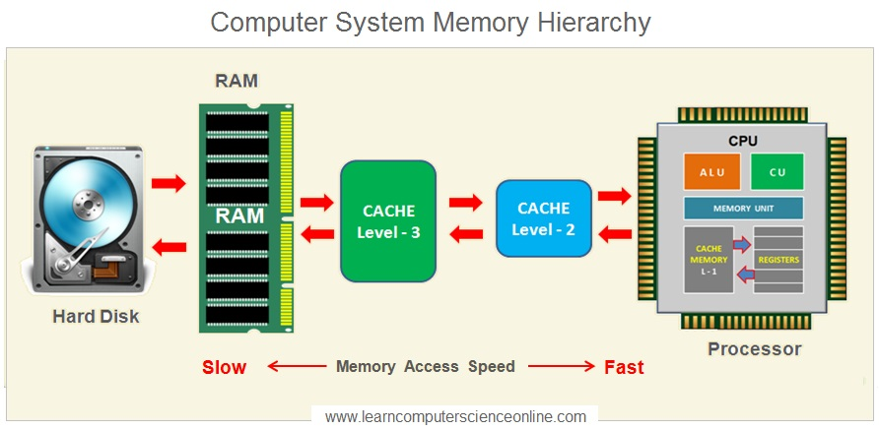

Slide 5
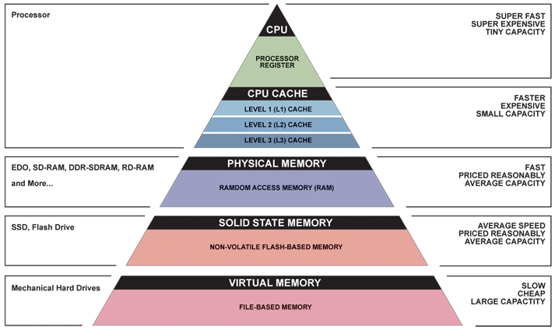
Memory Hierarchy Memory hierarchy goal: look ≈as fast as most expensive memory, ≈ as big as cheapest
Fast, Expensive,
but Small
Cheap, Large, but Small

Slide 6
Memory Hierarchy: Optimize Cost and Access Time
The fastest, smallest, and most expensive memory per bit at the top of the hierarchy and the slowest, largest, and cheapest per bit at the bottom.
Caches give the programmer the illusion that main memory is nearly as fast as the top of the hierarchy and nearly as big and cheap as the bottom of the hierarchy.

Slide 7
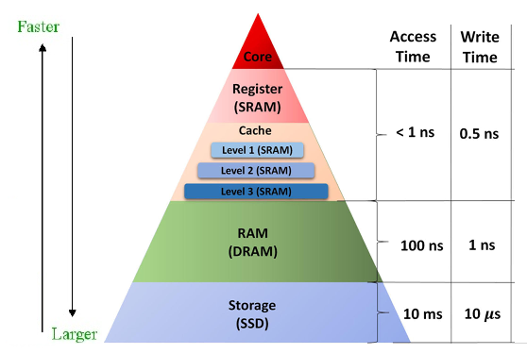
Hierarchy of Memories
The principle of locality states that memory that has been accessed recently is likely to be accessed again in the near future. That is, accessing recently accessed data is a common case for memory accesses. To make this common case faster you need a cache — a small high-speed memory designed to hold recently accessed data.

Slide 8
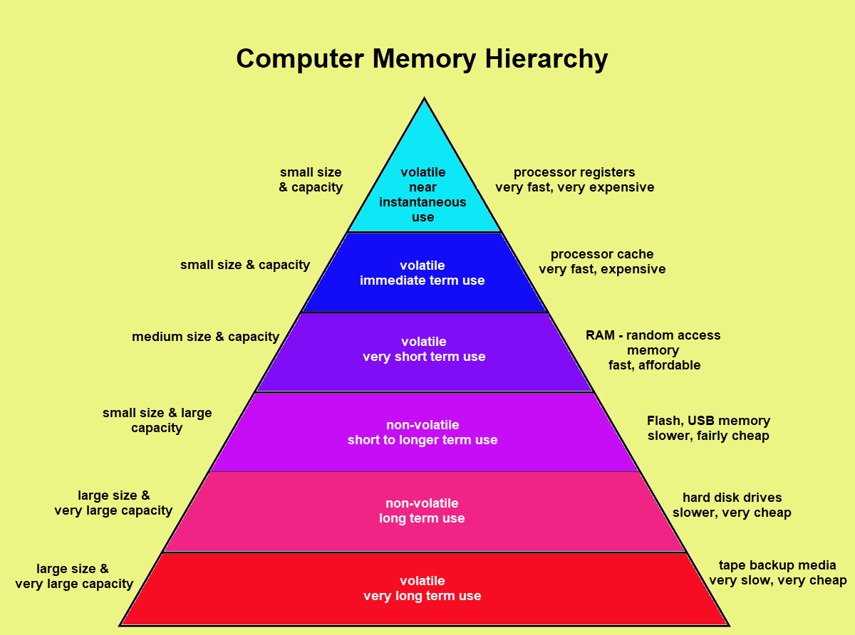

Slide 9
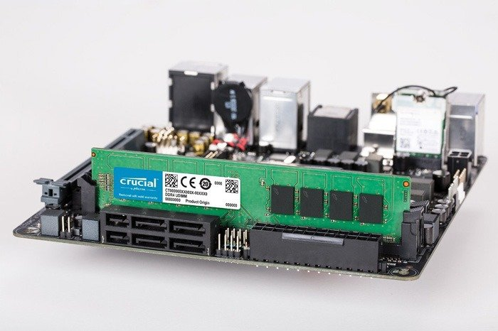
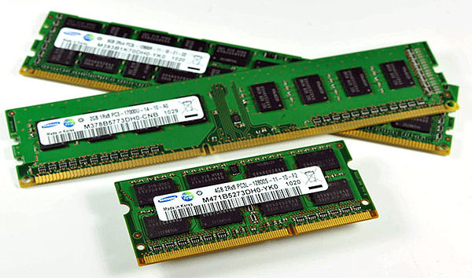
Memory

Slide 10
Memory
CPU has only few registers but most computational tasks require a lot more memory.
Main memory is the next fastest memory within a computer and is much larger in size.
RAM (Random Access Memory) is the most common form of Main Memory. RAM is normally located on the motherboard.
ROM (Read Only Memory) is like RAM except that its contents cannot be overwritten and its contents are not lost if power is turned off (ROM is non-volatile).

Slide 11
Although slower than register memory, the contents of any location in RAM can still be “read” or “written” very quickly. The time to read or write is referred to as the access time and is constant for all RAM locations.
RAM is used to hold both program code (instructions) and data (numbers, strings etc).
Programs are “loaded” into RAM from a disk prior to execution by the CPU.
Locations in RAM are identified by an addressing scheme e.g. numbering the bytes in RAM from 0 onwards.

Slide 12
Types of RAM
There are many kinds of RAM and new ones are invented all the time. One of aims is to make RAM access as fast as possible in order to keep up with the increasing speed of CPUs.
SRAM (Static RAM) is the fastest form of RAM but also the most expensive. Due to its cost it is not used as main memory but rather for cache memory. Each bit requires a 6-transistor circuit.
DRAM (Dynamic RAM) is not as fast as SRAM but is cheaper and is used for main memory. Each bit uses a single capacitor and single transistor circuit. Since capacitors lose their charge, DRAM needs to be refreshed every few milliseconds. The memory system does this transparently. There are many implementations of DRAM, two well-known ones are SDRAM and DDR SDRAM.
SDRAM (Synchronous DRAM) is a form of DRAM that is synchronised with the clock of the CPU’s system bus, sometimes called the front-side bus (FSB). As an example, if the system bus operates at 167Mhz over an 8-byte (64-bit) data bus , then an SDRAM module could transfer 167 x 8 ~ 1.3GB/sec.
DDR SDRAM (Double-Data Rate DRAM) is an optimisation of SDRAM that allows data to be transferred on both the rising edge and falling edge of a clock signal. Effectively doubling the amount of data that can be transferred in a period of time. For example a PC-3200 DDR-SDRAM module operating at 200Mhz can transfer 200 x 8 x 2 ~ 3.2GB/sec over an 8-byte (64-bit) data bus.

Slide 13
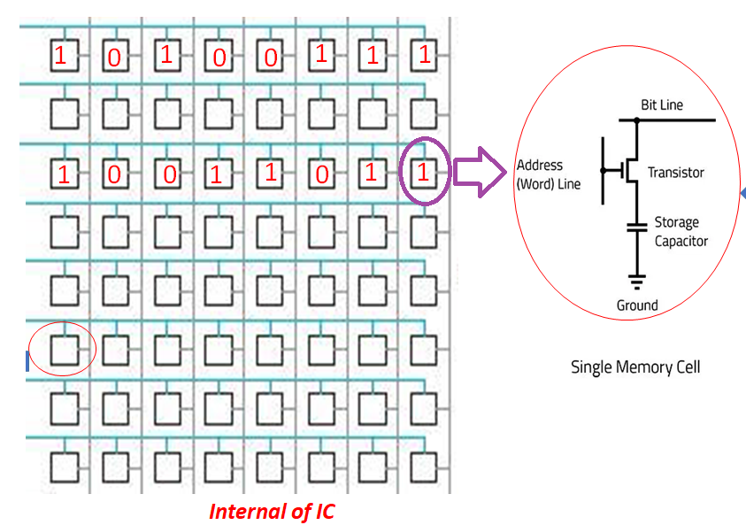
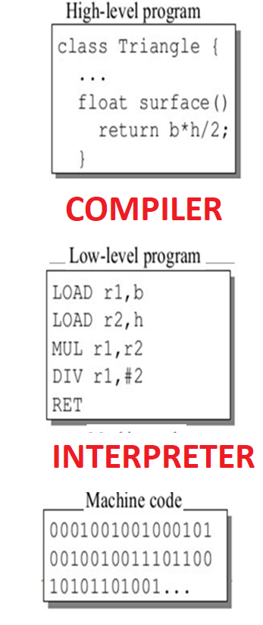
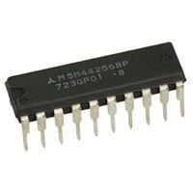
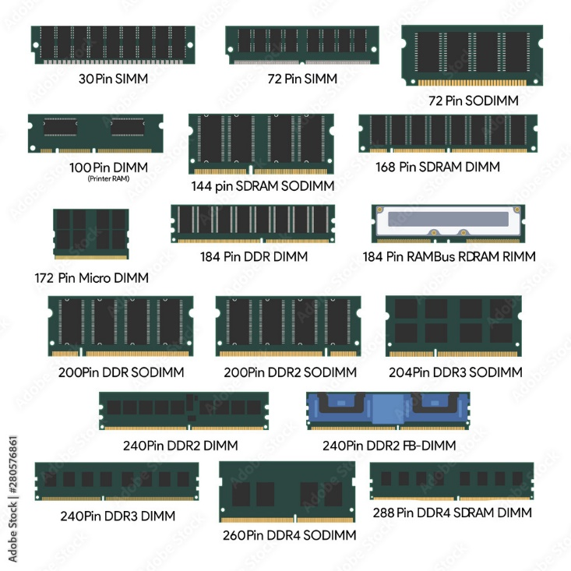
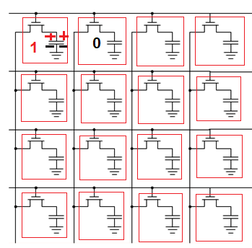
Memory is an array of storage, each having capacity of 8 bits or so and holds program and data in binary format

Slide 14
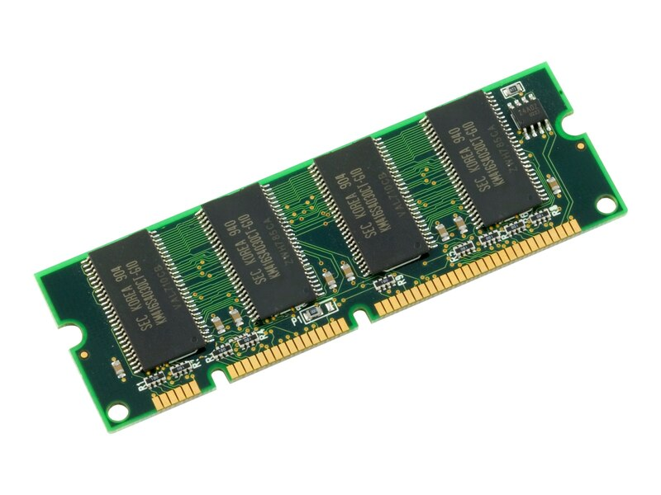
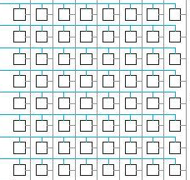
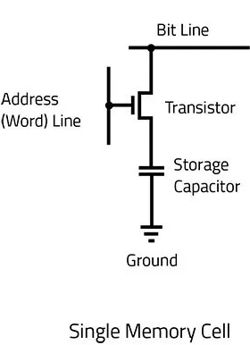
Module
Memory is an array of storage, each having capacity of 8 bits or so and holds program and data in binary format
User Program & Data
1
0
1
0
0
1
1
1
0101000001111111
1100000111100000
0101010100001111
1110000000111111
0101000001111111
1100000111100000
0101010100001111
1110000000111111
1
0
0
1
1
0
1
1
IC
Internal of IC

Slide 15
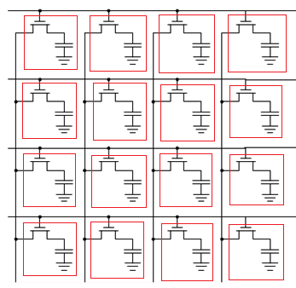
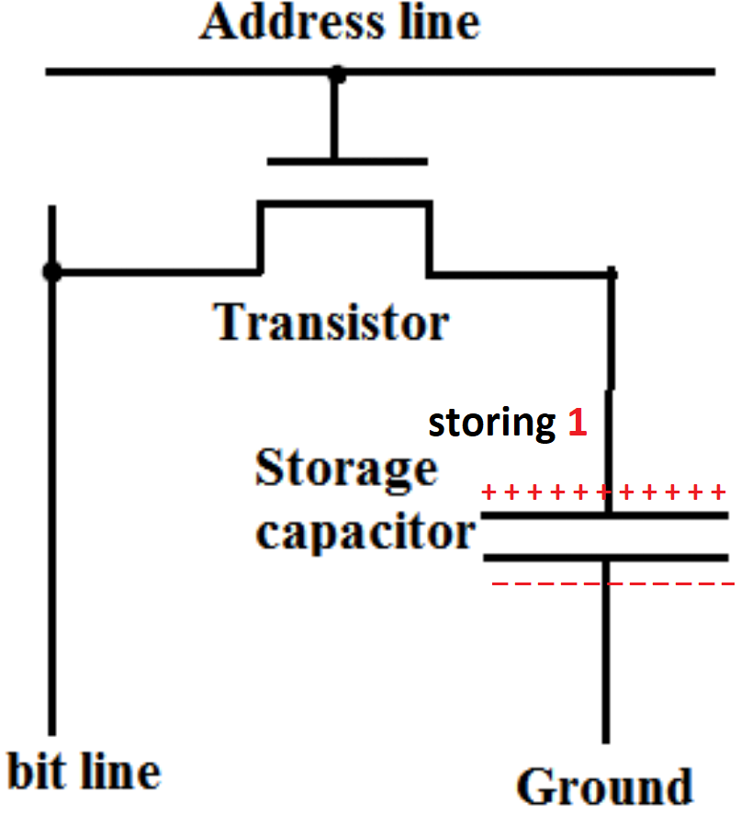
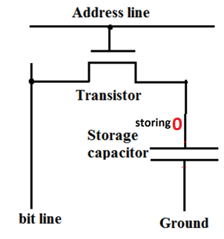
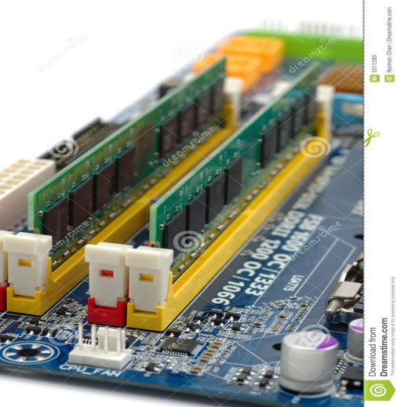
Program and Data
0101000001111111
1100000111100000
0101010100001111
1110000000111111
0101000001111111
1100000111100000
0101010100001111
1110000000111111
Stored in RAM

Slide 16
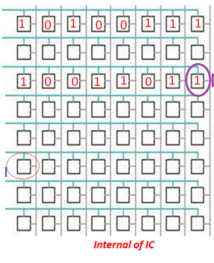
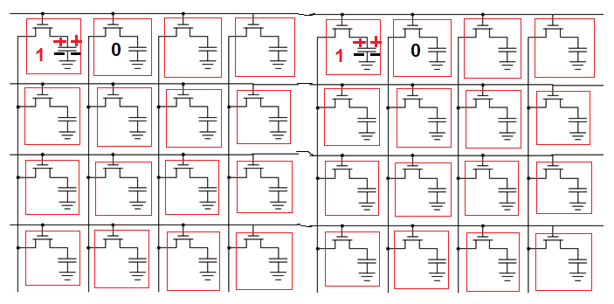
Main Memory
Main memory can be considered to be organised as a matrix of bits.
Each row represents a memory location, typically this is 1 Byte ( 8 cells contain 8 bits)

Slide 17
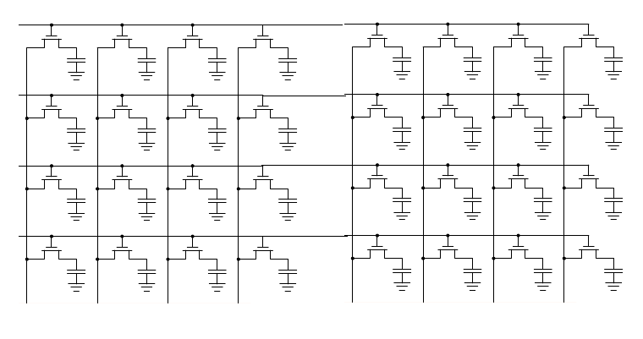
1
0
1
0
0
1
1
1
1
0
0
1
1
0
1
1

Slide 18
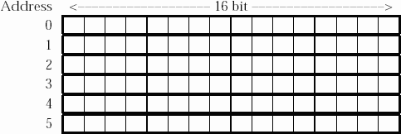
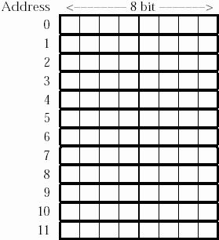
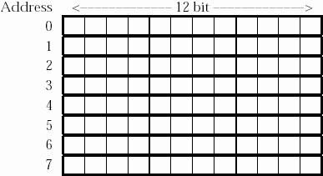
For a 96-bit memory we could organise the memory as 12x8 bits, or 8x12 bits or, 6x16 bits, or even as 96x1 bits or 1x96 bits.
Each row also has a natural number called its address which is used for selecting the row

Slide 19
Most architectures however, make Main Memory byte-addressable.
In such architectures the CPU and/or the Main Memory hardware is capable of reading/writing any individual byte.

Slide 20
Address in Binary
Address in HEX
Contents (Machine code & data)
Each row is uniquely identified by a number/code, starting from ‘0’, called Address, usually represented in Hexadecimal form and used in Assembly language programming
0H
1H
2H
3H
7H
0 | 0 | 0 | 0
0 | 0 | 0 | 1
0 | 0 | 1 | 0
0 | 0 | 1 | 1
0 | 1 | 1 | 1
1
0
0
0
1
1
1
0
0
1
0
0
0
1
1
1

Slide 21
Address in Binary
Address in HEX
Contents (Machine code or data)
If each location of memory contains 8 bits or 1 byte, then it is called
Byte-Addressable memory
0H
1H
2H
3H
7H
0 | 0 | 0 | 0
0 | 0 | 0 | 1
0 | 0 | 1 | 0
0 | 0 | 1 | 1
0 | 1 | 1 | 1
1
0
0
1
1
0
0
1
0
1
0
0
0
1
1
1
1
0
1
0
1
0
0
1

Slide 22
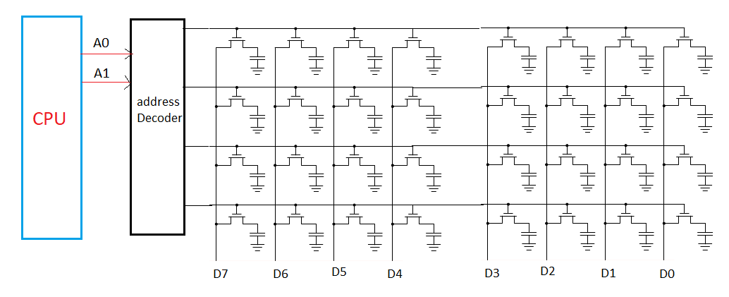
Interfacing CPU-RAM

Slide 23
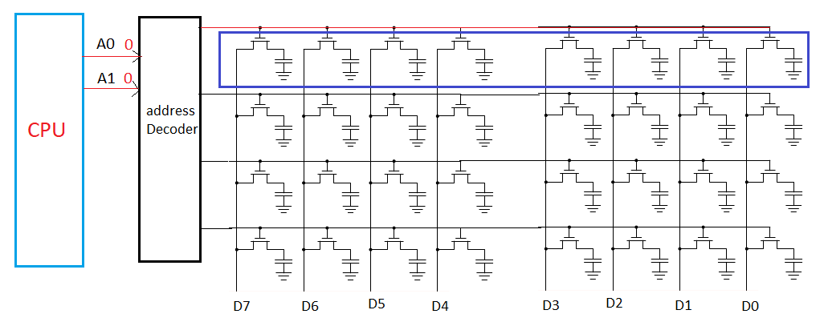
Interfacing CPU-RAM

Slide 24
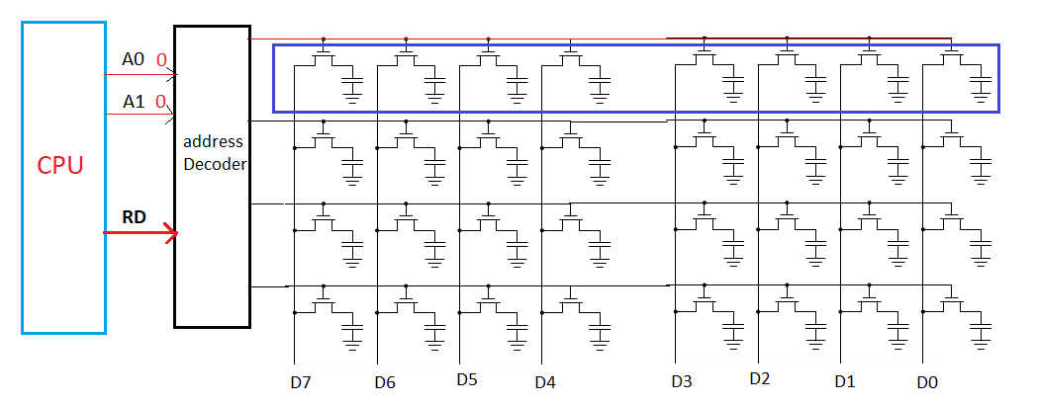
Interfacing CPU-RAM

Slide 25
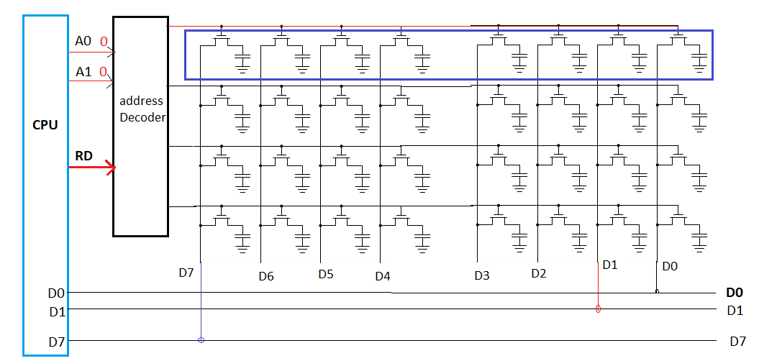
Interfacing CPU-RAM

Slide 26
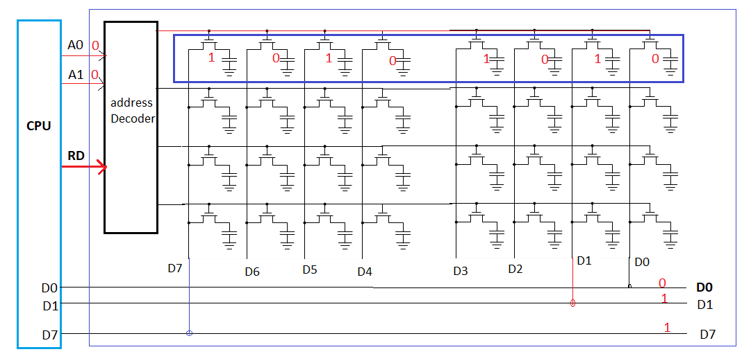
Interfacing CPU-RAM

Slide 27
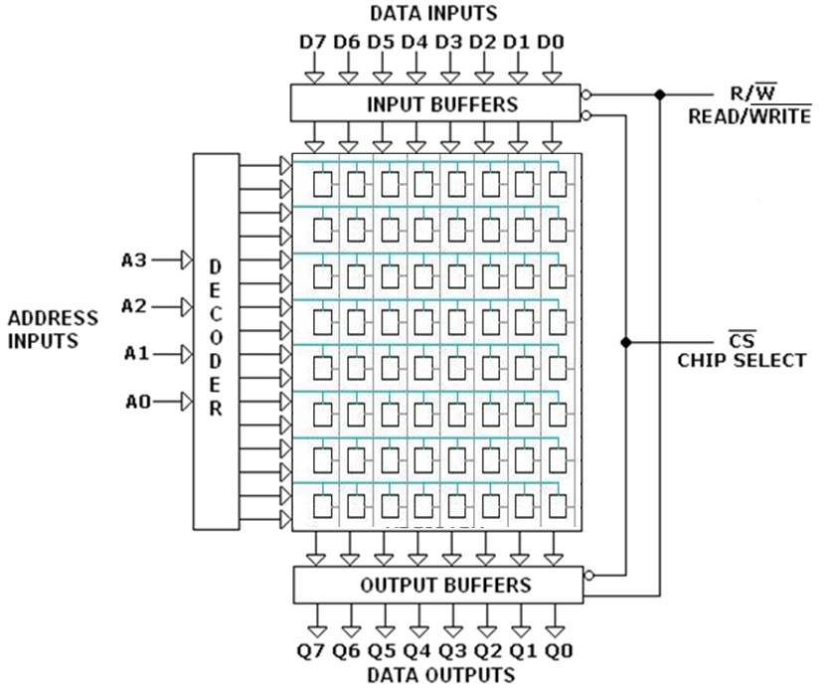

Slide 29
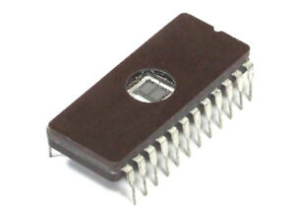
Example: 1KB IC (D2708)
1KB: Approximately 1 Thousand (exact value 1024) locations each having capacity of 8 bits/1Byte
Address starts at 0 and ends at 1 less than 1 Thousand, actually encoded in BINARY
In Binary, first address requires 1 bit (0) and final addressable location requires 10 bits (all 1’s: 11…11), since 2¹⁰ ⁼ 1K
For ease of Decoder design, uniform address format is used for all the locations; Maximum number of bits!
For convenience/ease of representation/programming/discussion, Hexadecimal number system is used to represent Memory address

Slide 30
Physical Address of Memory (for 1KB)
Address (10 bits in binary) | Content (8 bits)
1111111111B | 11001100 (machine code/data)
…
0000000000B | 00110101(machine code/data)
Address (3 digits in hexadecimal) | Content(8 bits)
3FFH | 11001100 (machine code/data)
000H | 00110101(machine code/data)

Slide 31
Capacity of Memory
Example: 1MB: Approximately 1 Million (exact value 1024 x 1024) locations each having capacity of 1Byte
Address starts at 0 and ends at 1 less than 1 Million, actually encoded in BINARY
In Binary, first address requires 1 bit (0) and final addressable location requires 20 bits (all 1’s: 11…11), since 2²⁰ ⁼ 1M
For ease of Decoder design, uniform address format is used for all the locations; Maximum number of bits!
For convenience/ease of representation/programming/discussion, Hexadecimal number system is used to represent Memory address

Slide 34
Byte Ordering
The ordering of bytes within a multi-byte data item defines the endian-ness of the architecture.
In BIG-ENDIAN systems the most significant byte of a multi-byte data item always has the lowest address, while the least significant byte has the highest address. In LITTLE-ENDIAN systems, the least significant byte of a multi-byte data item always has the lowest address, while the most significant byte has the highest address.
In the following example, table cells represent bytes, and the cell numbers indicate the address of that byte in main memory. Note: by convention we draw the bytes within a memory word left-to-right for big-endian systems, and right-to-left for little-endian systems.

Slide 37
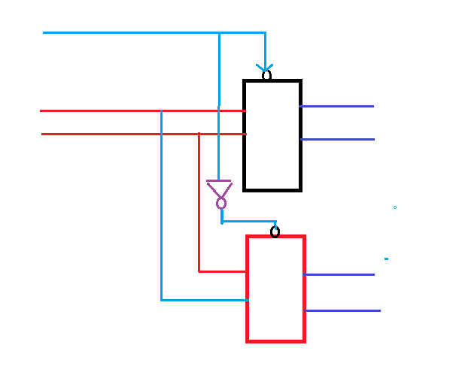
Expanding word size and capacity

Slide 38
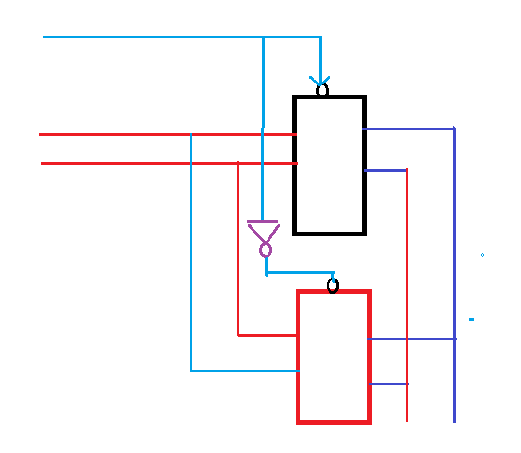

Slide 39
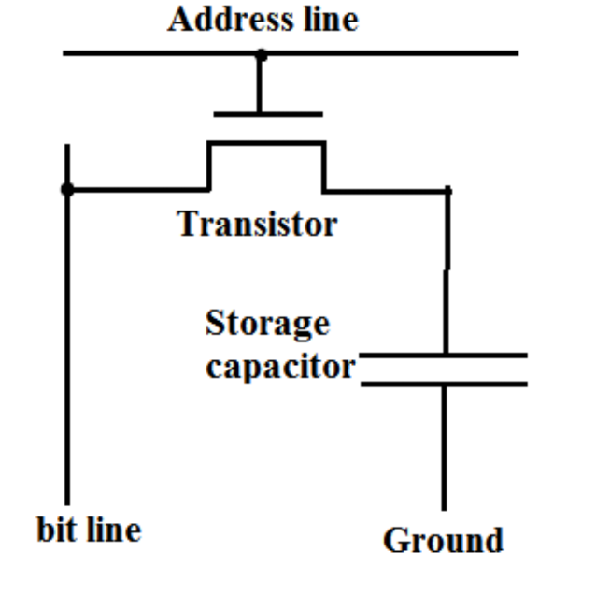
DRAM Basics: Internals, Operation
In DRAM, Binary “1” stored in a cell as a charge in a capacitor.
This circuit is dynamic because the capacitors cannot store charges indefinitely due to leakage current and discharge .
To retain information stored there, each capacitor in the DRAM must be periodically refreshed (i.e., read and rewritten). Refresh interval: 64ms.
A single transistor is then used to access this stored charge, either to read or write

Slide 40
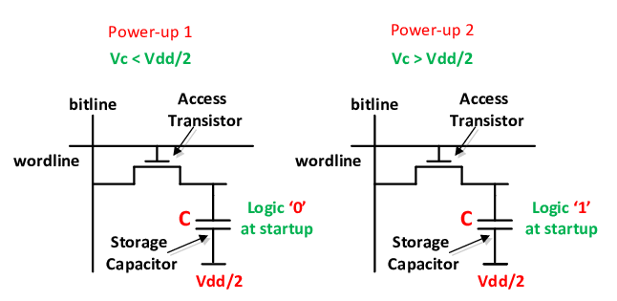

A typical DRAM cell has one transistor and one capacitor, as shown is Figure. It keeps its state in capacitor C. The transistor is used to provide access to the state. To read the state of the cell the access line Address Line is raised; this either causes a current to flow on the bit line or not, depending on the charge in the capacitor. To write to the cell the bit line is appropriately set and then Address Line is raised for a time long enough to charge or drain the capacitor. A DRAM cell is much simpler than a other cell, allowing for greater memory density (being a smaller cell) and lower manufacturing cost.

Slide 41
DRAM has a number of drawbacks:
In order to allow huge numbers of cells, the capacity of the capacitor must be low. It only takes a short time for the capacity to dissipate, which is known as current leakage.
In order to address this problem, DRAM cells must be refreshed frequently (every 64ms in most current DRAM devices).
This tiny charge also creates another issue: the information read from the cell is not immediately usable, since the data line must be connected to a sense amplifier which can distinguish between a stored 0 or 1.
Finally, the capacitor is discharged by read operations, so every read operation must be followed by an operation to recharge the capacitor. This requires time and energy.

Slide 42
Several arrays are read at the same time to provide the contents of a memory word. This group of arrays ganged together are called banks.
Layer-0
Layer-1
Layer-2
Layer-3

Slide 43
Several arrays are read at the same time to provide the contents of a memory word. This group of arrays ganged together are called banks.
C
P
U
Row decoder
Layer-0
Layer-1
Layer-2
Address lines
Address lines
Layer-3
For DRAM, Separate address lines for Row and Column
Row and Col addresses are applied simultaneously
Address lines
Address lines
Column Decoder
Data Lines

Slide 44
To reduce the size of DRAM IC, the number of address lines is reduced: Memory address pins are reduced to half the required number and multiplexed between row and column
RAS
C
P
U
Row decoder
Layer-0
Memory
controller
Row address latch
Layer-1
Layer-2
Address lines
Layer-3
Address lines
Row Add
Col address latch
Col Add
Column Decoder
CAS

Slide 45
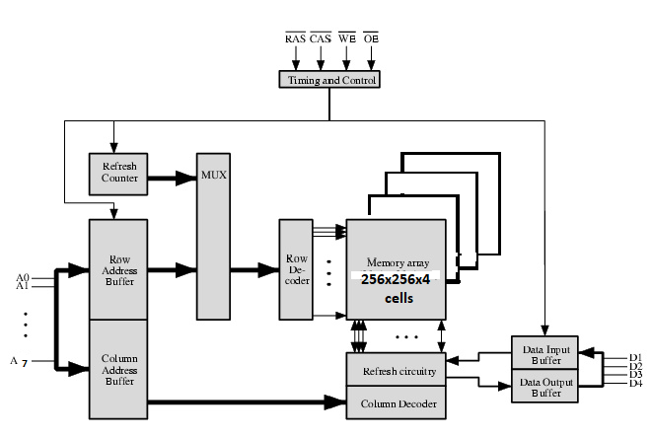
64K x 4 bits DRAM

Slide 50
Math problems
For the 8-bit word 00101011, calculate the check bits. Suppose when the word is read from memory, the check bits are calculated to be 0010.What is the data word that was read from memory?
A 12-bit Hamming code word containing 8 bits of data and 4 parity bits is read from memory. What was the original 8-bit data word that was written into memory if the 12-bit word read out is 010011111000
A 12-bit Hamming code word containing 8 bits of data and 4 parity bits is read from memory. What was the original 8-bit data word that was written into memory if the 12-bit word read out is 110011011011 (show the procedure)?

Slide 52
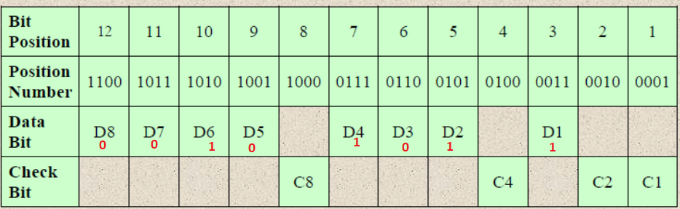
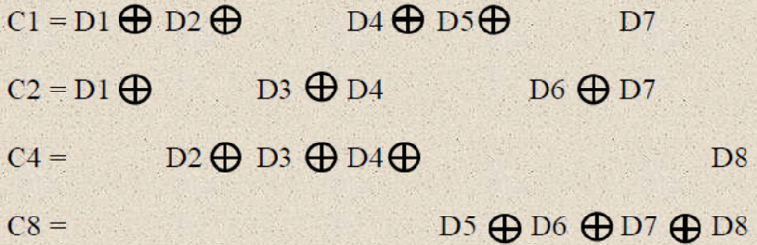
For the 8-bit word 00101011, calculate the check bits. Suppose when the word is read from memory, the check bits are calculated to be 0010.What is the data word that was read from memory?
C1= 1
C2= 1
C4= 0
C8= 1

Slide 53
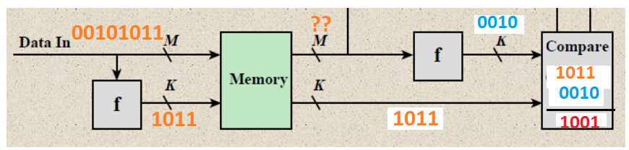
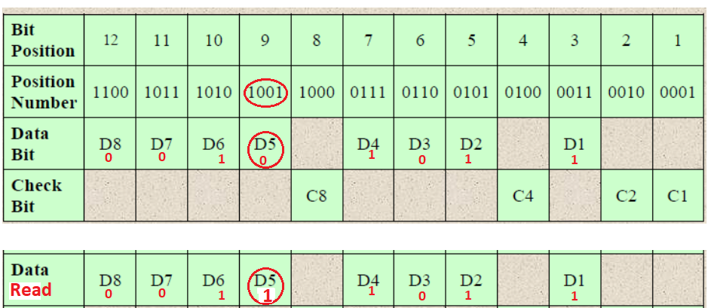
solution

Slide 54
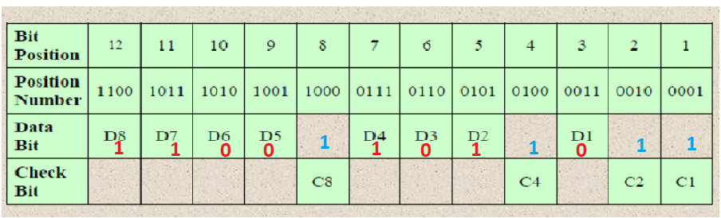
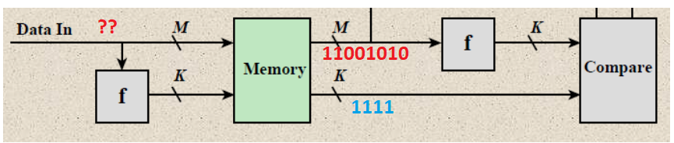
A 12-bit Hamming code word containing 8 bits of data and 4 parity bits is read from memory. What was the original 8-bit data word that was written into memory if the 12-bit word read out is 110011011011 (show the procedure)?

Slide 55
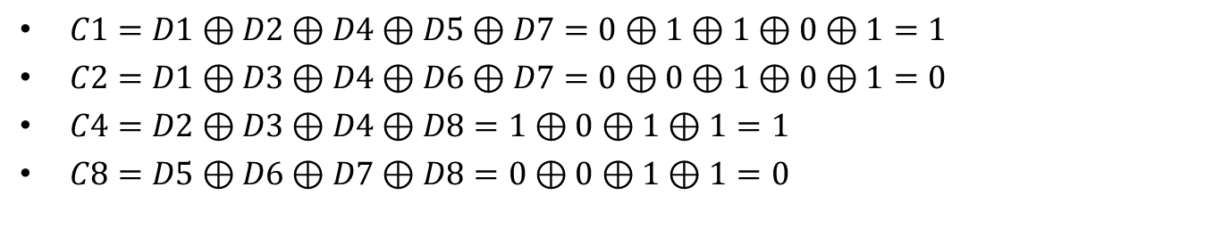
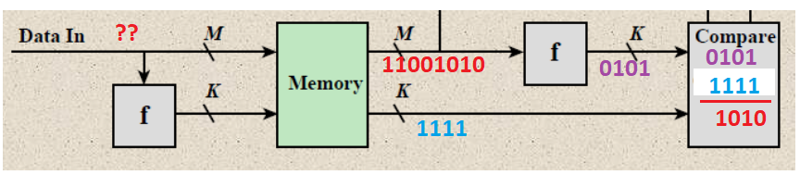
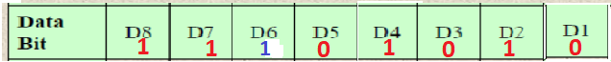
Calculation checker bits from fetched data bits:

